Slide 1

Reconnect and Rise
A support booklet for parents as their children return to school

Slide 2
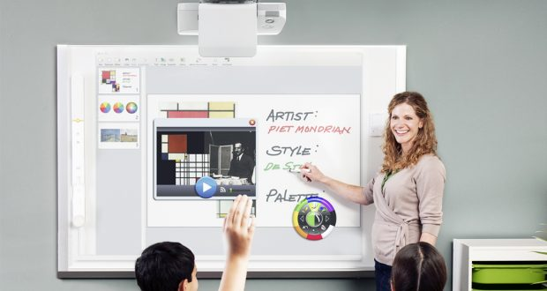
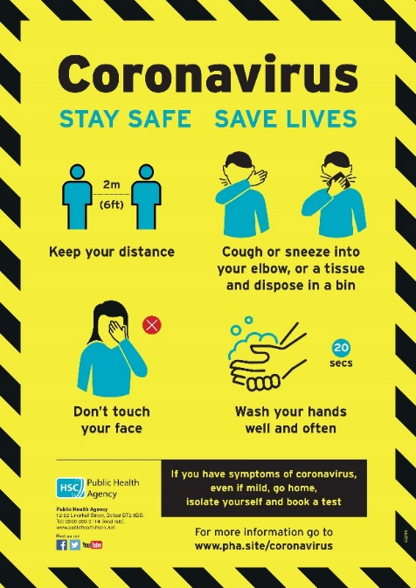
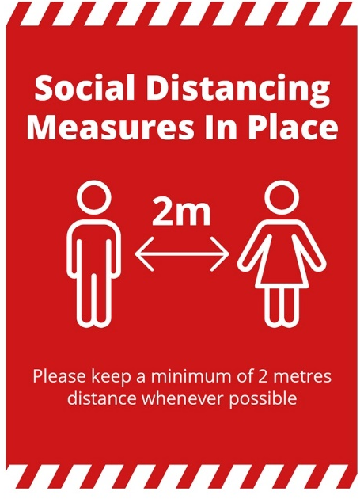
Preparing for Education Restart

Slide 3
Parents- guide to supporting your teenager as they return to school
Lockdown was a massive change for all of us - including our young people. As they return to school, we need to help them prepare for another big change.
Top Tips
Talk through what school will be like - and what will happen during the day - so your child knows what to expect
Make time to talk about any worries they may have
Let them see you looking calm and in control (even if you feel differently on the inside)
Ease them back towards normal bedtimes (so they're not exhausted on their first day back)
Take care of yourself (so you can take care of your child)

Slide 4
Where do we start?

Slide 5


