Slide 1

Reconnect and Rise
A selection of assembly and class based activities to support your school community as it comes back together again.

Slide 2
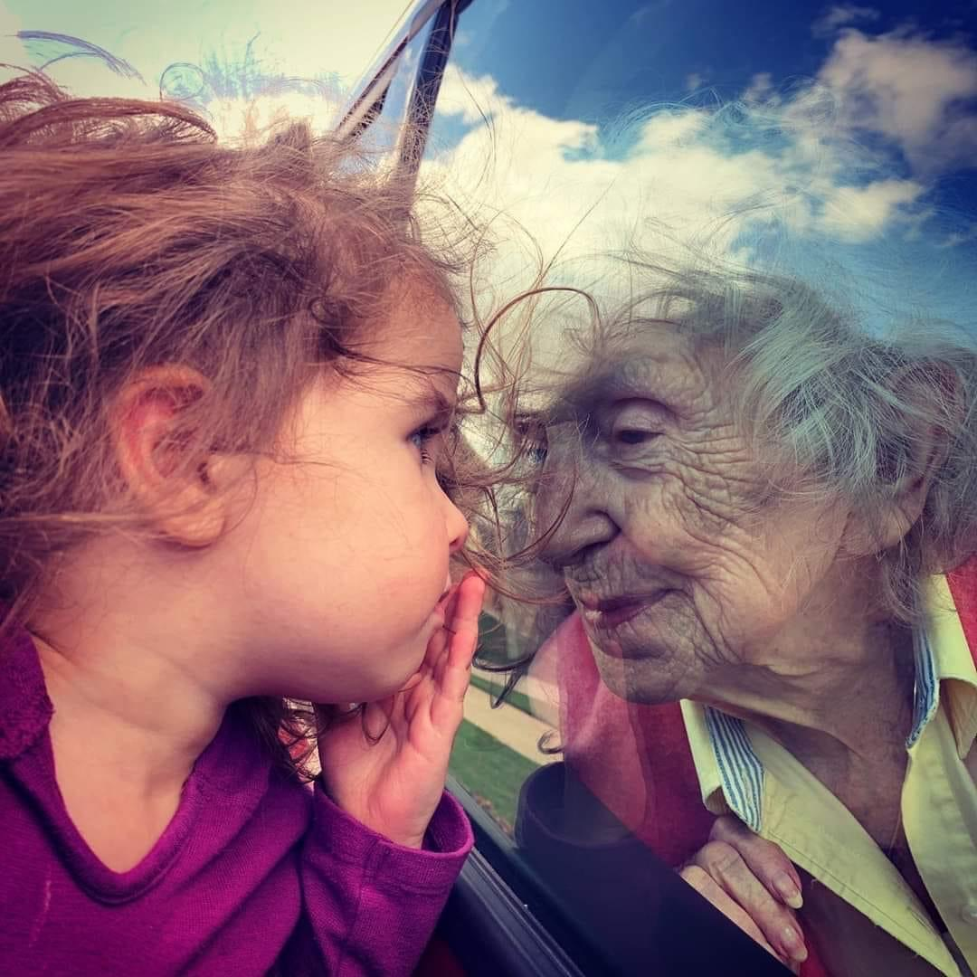


Section Two, Theme 2
Connectedness

Slide 3

Assembly
What ways did you feel more connected to your community during lockdown?
Clap for carers- Thursday Night 8pm
Helping others out- those shielding/vulnerable making sure they had food and got their essential items
How was this visible in shops in our community – opening hours etc.
How can we keep this going in this next phase?
Random Acts of Kindness- each form class will develop their own idea for a random act of kindness over the next fortnight

Slide 4

What we have learned..
No man is an island,
Entire of itself.
Each is a piece of the continent,
A part of the main.
If a clod be washed away by the sea,
Europe is the less.
As well as if a promontory were.
As well as if a manor of thine own
Or of thine friend's were.
Each man's death diminishes me,
For I am involved in mankind.
Therefore, send not to know
For whom the bell tolls,
It tolls for thee.

Slide 5

As we reconnect with our school community- what are we looking forward to the most
What school values will we try to focus on as we reconnect?

Slide 6
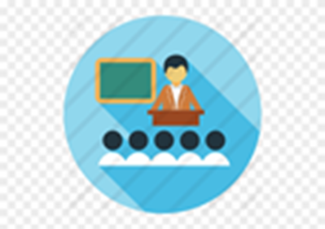
Reconnecting with our school/class community
Ways we can greet each other
Ways we can help each other
Random acts of kindness
Kindness to ourselves
Kindness to each other
Kindness to bigger school and local community- local charities/food banks etc.

Slide 7
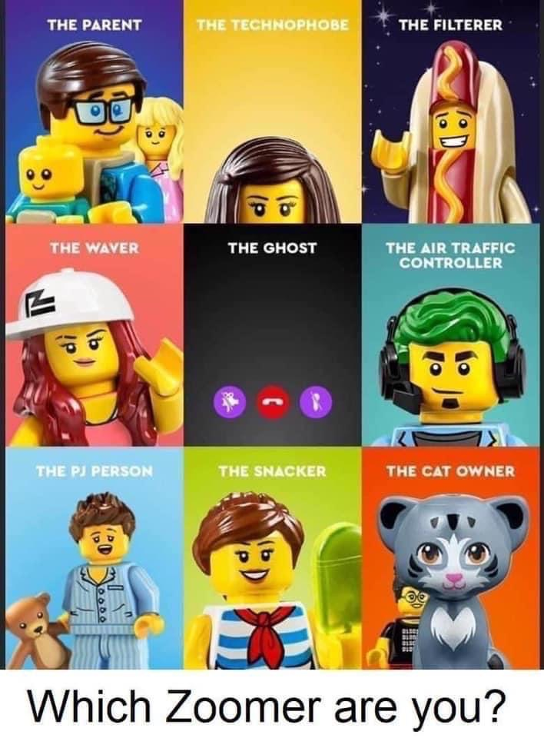
School Community
Ways that school kept in touch
Ways we kept in touch with each other- who had heard of ZOOM before lockdown?

Slide 8

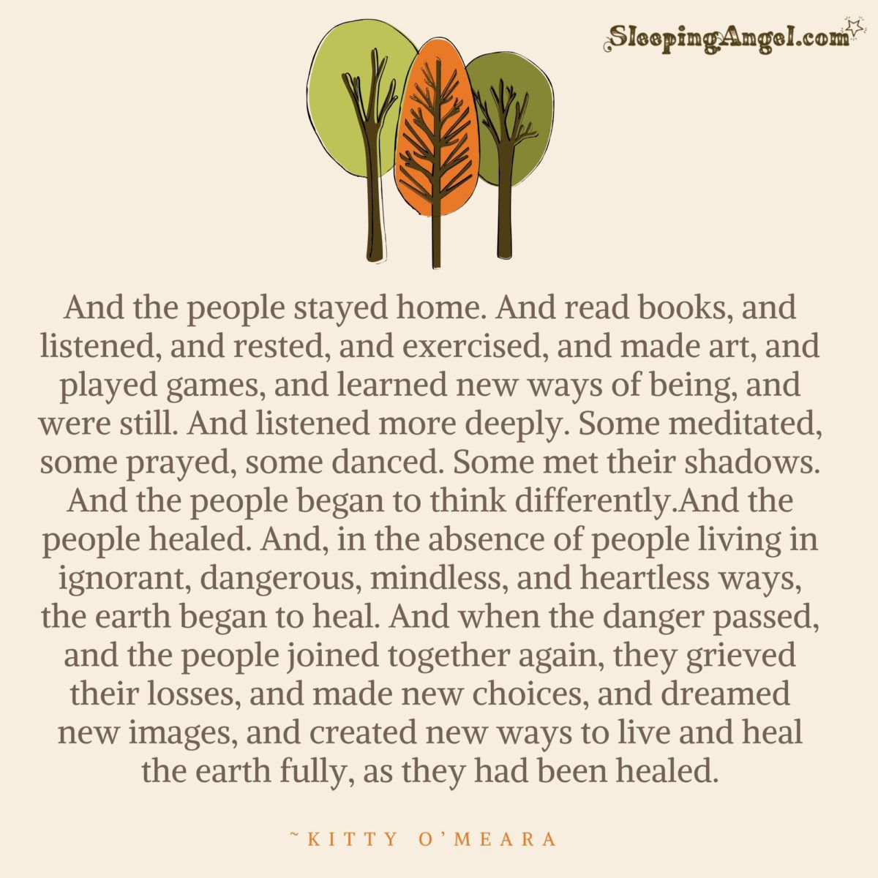

Slide 9
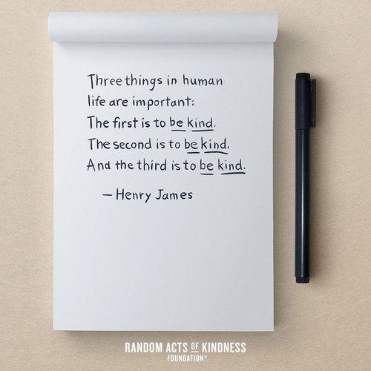
Class challenge of the week
Random act of kindness-
Decide on a class act of kindness for a member of school staff or another class in school
What are small ways we can show kindness and help people feel connected to each other?
Give each pupil another pupil’s name in the class, their challenge is to show this pupil a random act of kindness before next week’s form class.

