Slide 1

Reconnect and Rise
A support booklet for parents as their children return to school

Slide 2
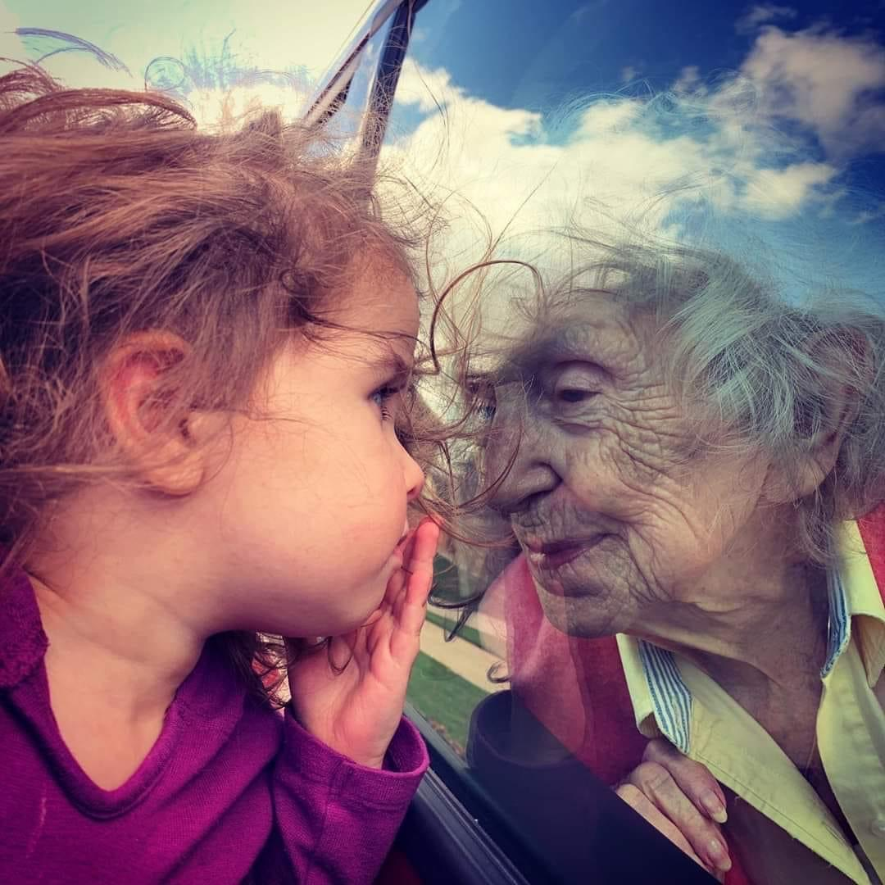


Theme 2 Connectedness

Slide 3
Connection
The next theme your child will explore in school is Connectedness.
Due to the Covid Restrictions we felt disconnected from many important parts of our ‘normal’ lives we missed family, friends and time to ourselves in our hobbies and social activities.
Most of our young people were unable to attend school, hobbies and social activities and many were unable to see and spend time with extended families and friends.
This long break from school will mean that many feel they are starting all over again in school, worrying about friendships, relationships with teachers etc.

Slide 4
Connection
It’s important to realise that humans are innately collective creatures, we do not exist as individuals. This is biological and innate within us and our collective nature is why we became top of the food chain!
The separation we have experienced was very difficult and very unnatural for us – the normal thing we do during times of stress or loss is to come together, not stay apart. We were ‘staying safe’ at home and now it is naturally scary to rejoin the world outside our homes.
For adolescents, this is also particularly difficult as they are going through a period of development where peer interaction is more important and meaningful to them than family interaction.
Connection with others is therefore more important than ever as we don’t feel like we are real people without connections to other people.

Slide 5
What Just Happened
Coping with COVID-19A guide to support parents & carers of children
WHAT JUST HAPPENED? See booklet linked.

