Slide 1

Transition for Parents: Supporting the Child with ASD in the Early Years
Autism Advisory and Intervention Service
Notes:
Welcome to the Autism Advisory and Intervention Service transition training for parents. Many of us find change challenging, moving from something we are familiar and comfortable with to something unknown and uncertain.
We hope that this training help you to effectively support your child’s transition from one setting to another. That might be from home to a playgroup or nursery or it may be from a playgroup or nursery into primary one. Or perhaps it is moving to a new class into year two or year three with a new teacher. Whatever the transition ahead for you and your family at this moment, we hope that you will find some of our ideas useful.

Slide 2
Aims
An understanding of Autism Spectrum Disorder and its implications for the transition process
To provide a range of practical strategies and resource materials to support your child through the transition process
To explore the need for communication between home and your child’s new setting/class
Notes:
Through this training we hope to further develop an understanding of autism spectrum disorder. We will consider how or why a child with autism may find transition challenging. We will offer some practical advice and provide and discuss resources to help you to support your child as they transition into their new setting. and to help you to communicate effectively with the staff that will be working with your child.

Slide 3

What is ASD?
Autistic Spectrum Disorder is a complex developmental disability that essentially affects the way a person communicates and relates to people.
Task Group on Autism (2002)
Children who have an autistic thinking style see the world in a different way from the majority of other children.
Their behaviour can sometimes seem difficult to understand.
They will learn about the world in a different way.
Notes:
So what is ASD? ASD or Autistic Spectrum Disorder is a complex developmental disability that essentially affects the way a person communicates and relates to people. Children who may be described as having an autiistic thinking style often see the world in a different way from the majority of other children, sometimes their behaviour can seem difficult to understand. They’re not sure why they are reacting in the way they are. They’re learning about the world in a different way.

Slide 4
Remember…
The characteristics of Autism vary in severity and one person’s profile may change over time and with development.
Individuals with Autism are unique. It is important to remember that not every child will react in the same way to the same situation.
Notes:
We need to remember that every child is unique and no two children will present in exactly the same way. Indeed a child’s reaction may differ over time, perhaps as they mature or maybe depending on their current circumstances and environment, their mood and their general well being.

Slide 5
The Triad of Impairments Wing & Gould, 1979
Social Interaction
Triad Of Impairment
Social imagination and Flexibility of Thought
Social Communication
Notes:
It’s important for us to consider the challenges children may face in relation to their diagnosis of autism. These difficulties are often referred to as the triad of impairments. These are three areas within which, children with autism may have difficulty. Social communication, social interaction and social imagination and flexibility of thought. As we go through this presentation we are going to look at each of these areas in more detail.

Slide 6

Strengths
Common skills, strengths and abilities of children with an ASD diagnosis:
strong visual skills
an eye for detail
logical thinking
good technical ability
good rote learning skills
ability to acquire detailed factual knowledge
ability to learn and follow routines
ability to focus with sustained attention for long periods of time on an area of special interest.
Notes:
Children with autism spectrum disorder may also have particular strengths and perhaps they have strong visual skills or an eye for detail, they may be good logical thinkers and have good technical ability. They may have the ability to learn by rote or the ability to acquire deailed factual knowledgesuch as those listed. If we use autism specific strategies which incorporate these strengths we can support children with ASD more effectively.

Slide 7
Social Communication
Your child may have difficulty with…
expressive and receptive language
establishing relationships and meeting new people e.g. other children and adults in the new setting
reading social cues e.g. tidy up time/ snack time
understanding language e.g. take things literally
reading the situation e.g. tone, intonation, body language
Notes:
A child with social communication difficulty may struggle with expressive and receptive language. They may have difficulty understanding what is said to them and making their needs and wants clear to others. They may have difficulty establishing relationships and meeting new people, this includes other children and adults in their new setting. They may struggle to read social cues and therefore have difficulty understanding what is happening or why.

Slide 8
Social Interaction
Your child may have difficulty with…
sharing, turn taking and waiting
being part of a group
understanding the thoughts and feelings of others
forming and maintaining friendships
Notes:
Your child may have difficulty with sharing, turn taking and waiting, being part of a group. They may have difficulty understanding the thoughts and feelings of others and struggle to form and maintain friendships. Learning these skills, helps us to build relationships with others.

Slide 9
Imagination and Flexibility of Thought
Your child may have difficulty with…
generalising knowledge and skills e.g. self help skills (putting on coat, peeling banana)
coping with change e.g. indoor/ outdoor play
fixed ideas e.g. big toilet at home, little toilet at school
special interests e.g. sand, water, cars
following the agenda of others
Notes:
And the third area of the triad of impairments – imagination and flexibility of thought. Your child may have difficulty with generalising knowledge and skills., that difficulty with transferring knowledge and skills from one place to another. Sometimes they can do things in school they can’t do at home and vice versa. They may have difficulty with change; something not happening that was meant to happen

Slide 10
The Fourth Factor: Sensory Sensitivities
Social Interaction
Sensory difficulties
Triad Of Impairments
Social Communication
Social imagination and Flexibility of Thought
Notes:
Alongside difficulties related to the triad of impairments, children with autism may also have some degree of sensory sensitivities. These too, may impact on their experience of transitioning between settings. We are going to consider some of the sensory difficulties your child may present with.

Slide 11
Sensory Difficulties
Sight
Distracted by displays and lights
Seeking out toys or objects that move or flicker
Smell
seeking out smells from clothes or hair of others
Overwhelmed by strong smells e.g. coffee, crisps, perfume/deodorant
Sound
Dislike loud noises such as hand drier or school bell
Overwhelmed by noise in playground or classroom
Seeking out sounds e.g. from certain musical instruments, hums or sings
Taste
May include mouthing or licking objects
Restricted diet
Touch
Dislikes messy play or art and craft e.g. sand, paint or play dough
Dislike lining up or being close to others
Gets too close to others
Can appear rough during play
Notes:
Sight – some children may be distracted by lights and patterns on displays, perhaps focusing on these intently to the exclusion of everything else. They may actively seek out c=visual stimulation, looking for toys that move or flicker. Smell – some children with seek out smells from the clothes or hair of others and may even sniff people. They may be overpowered by strong smells and tell you so in o uncertain terms. This aversion to smell can sometimes be a difficulty at dinner times.
Sound – some children can be startled and react strongly to loud noises and perhaps will try to leave the room to escape. Some children appear to constantly make noise themselves, tapping, humming or singing.
Taste – Children may mouth or lick items, some may have a very restricted diet, preferring foods with a particular texture or taste and avoiding foods which do not fall within these categories.
Touch – Sometimes children will avoid messy or sticky activities or they might insist on being cleaned up right away. For some children, understanding personal space can be a challenge. Perhaps they will dislike being too close or indeed may get too close to others and can appear rough in their actions.

Slide 12
Sensory Difficulties
Proprioceptive
Seeks excessive pressure from way they hold objects or hugging others
Bangs body parts
Throws self against objects
Vestibular
Always fidgeting or on the move
Dislikes movement
Fearful of sitting on the toilet
Interoception
Limited awareness of needing to use the toilet
Not aware of signs of hunger
Difficulty identifying feelings
Notes:
And there are other, less familiar senses to consider.
Proprioception – this is an awareness of the position and movement of our bodies. Children with proprioceptive difficulties may seek excessive pressure from the way they hold objects or hug others. They maybe bang against themselves, slapping their legs or their arms or throw themselves against objects.
The vestibular sense is related to balance. Children with challenges in this area may be always fidgeting or on the move. They may dislike certain types of movement for example on a swing. They may be fearful of sitting on the toilet because of the hole underneath them and not feeling secure.
The sense of interoception helps us to understand what is going on inside our bodies, it is how we identify pain, hunger or tiredness. Children with interoception difficulties may struggle with toilet training. They may have difficulty identifying and recognising their feelings and emotions. All of the difficulties related to the triad of impairments and sensory processing issues can impact upon a child’s ability to transition smoothly between educational settings.

Slide 13


What is Educational Transition?
Educational transition is defined as the process of change that children make from one place to another or from one educational setting to another over time (Fabian, 2002)
Starting a new school/class can be a very difficult and anxious time for both children and parents. Planning for this transition is very important, especially for children on the Autism Spectrum
Notes:
What is Educational Transition? Educational transition is defined as the process of change that children make from one place to another or from one educational setting to another over time. We know that starting a new school or class can be a very difficult and anxious time for both children and parents and that’s why planning for this transition is very important, especially for children on the autism spectrum.

Slide 14
Why have a Transition Programme?
Your child may have difficulty with…
coping with change
generalisation of skills
organising themselves and their belongings
interacting with others and developing friendships
communicating their needs and asking for help
understanding and an awareness of danger
Notes:
So, why do we have a transition programme? Your child may have difficulty coping with change. They may have difficulty with generalization of skills and transferring knowledge between different places. They may struggle to organize themselves and their belongings. They may find it hard to interact with others and develop friendships. They find it difficult to communicate their needs and ask for help when they need it. They may not have a good understanding and awareness of danger. By recognising the difficulties your child may face we can begin to plan ways in which to support them to manage these challenges.

Slide 15

Possible New Experiences
Longer day
Structure to the day
Different room size and layout
Different lighting and furniture
New and unfamiliar equipment
Different toilets, eating area, cloakroom and outdoor play area
Different sensory experiences (new sounds, sights, textures, new foods, smells etc.)
Having to manage toileting, dressing and eating independently
Choice of resources
Notes:
Let’s consider some of the possible new experiences your child may encounter next year. Perhaps they will have a longer day including staying for lunch. There may be increased structure to the day and expectations to do certain things at particular times. There may be changes to the environment, a different building or room, new equipment. Children may have different toilets, cloakroom and play areas. They may even eat lunch in another room. There will be a range of sensory experiences associated with these. There might be different expectations for self care and personal organisation.

Slide 16
Possible New Experiences Continued…
New set of rules, routines and expectations
New language and vocabulary
Building relationships with staff and other children
Increased verbal instruction
New travel arrangements
New clothing/uniform
Managing own belongings e.g. coat, lunch box, school bag or P.E. kit
Notes:
A different setting will have it’s own rules, routines and expectations and terminology associated with these. Children will meet different staff and peers and need to establish relationships with them. The language used and instructions given may be different and unfamiliar. Perhaps there will be new arrangements in place for drop off in the morning and collection in the afternoon. For many children there will be a new uniform to wear. Children may be encouraged to be responsible for their own belongings and make sure they have them at the right time. All of these possibles changes can cause some degree of concern and anxiety.

Slide 17

Family Perspective
Will my child …..
settle
display challenging behaviour
make friends
eat
make progress
manage the toilet
need help
Notes:
All parents will naturally worry about their child’s move to a new setting or environment. You might be concerned about your child settling in. You may be concerned about their behaviour, what will happen if they act out or have a meltdown? Will they make friends and enjoy being with others? Will they have something to eat during the day and what if they refuse what is offered? You might worry about them not making progress. You might be concerned about what happens if they need the toilet and struggle to ask or cant manage when they get there. You might have questions around your child needing help, how staff are going to know and will they be given the support they need. You will have other personal concerns related to your individual child.

Slide 18


Concerns
Although starting school may not be your child’s first transition, it is often seen as the first major one
Leaving your child in the care of another person can be a time of mixed emotions e.g. fear, anxiety, loss, expectation, excitement and hope
Moving to a new year group can provide its own unique challenges
Try not to let your child overhear any worries or concerns about it
Stay positive and try to re-assure your child
Notes:
Although starting school may not be your child’s first experience of transition, it is often seen as the first major one. Leaving your child in the care of another person can be a time of mixed emotions. There may be fear, anxiety, loss, expectation, excitement and hope. Moving to a new year group can provide its challenges. Try not to let your child overhear any worries or concerns you may have. Stay positive and try to re-assure your child. It’s really important to build a good relationship with your child’s new setting. Talk to the staff there and be open and honest with your concerns. Plan together ways in which your child can be supported.

Slide 19
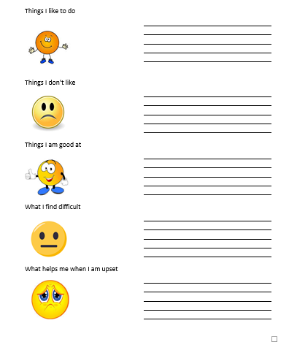
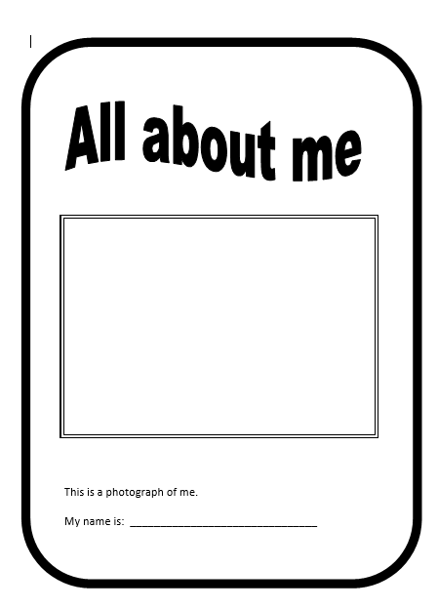
Preparing for Transition
Complete the ‘All About Me’ booklet so that staff working with your child have as much information as possible
Notes:
When preparing for transition, the more information you share and the more open and honest you are about your child and their needs, the better equipped staff will be to support them. It is useful to complete an all about me booklet to provide staff with important information about your child’s likes and dislikes, their strengths and things they find challenging. It is also useful to share information about their favourite items or how to calm them if they are upset. All of this helps staff to build a positive relationship with your child and personalise strategies to support them in their new setting.

Slide 20
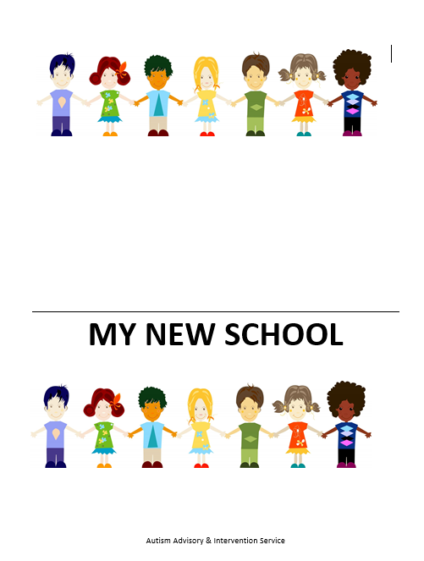
Transition Top Tips
Your child may benefit from a ‘My New School’ booklet
Some schools may already have a ‘My New School’ booklet they use to help their new pupils prepare for starting school, however this may need to be personalised for your child
This booklet will contain photographs to enable you child to become familiar with their new setting
Notes:
Children with autism benefit from familiarising themselves with their new setting and staff. A new school booklet contains photographs and information that may help them do this. You and your child can look at the booklet over the summer months, talking about the new school and starting to prepare them for the beginning of term. It may also be useful to look at the school’s website for more photographs of the staff and the school. If your child is moving between year groups in the same school a booklet can be created relating to my new class.

Slide 21
‘My New School’ Booklet
May contain photographs of following:
staff
specific areas within the setting, for example,
playground
toilets
dining hall
cloakroom
uniform
transport (if applicable)
Notes:
A new school booklet may be personalised to include information relevant to your child. You might want to consider photographs of key adults and specific areas within school. The next slides show an example of what might be included.

Slide 22
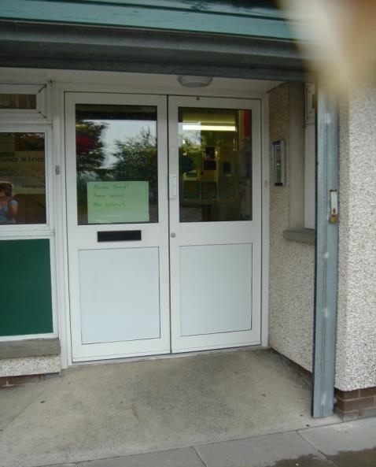
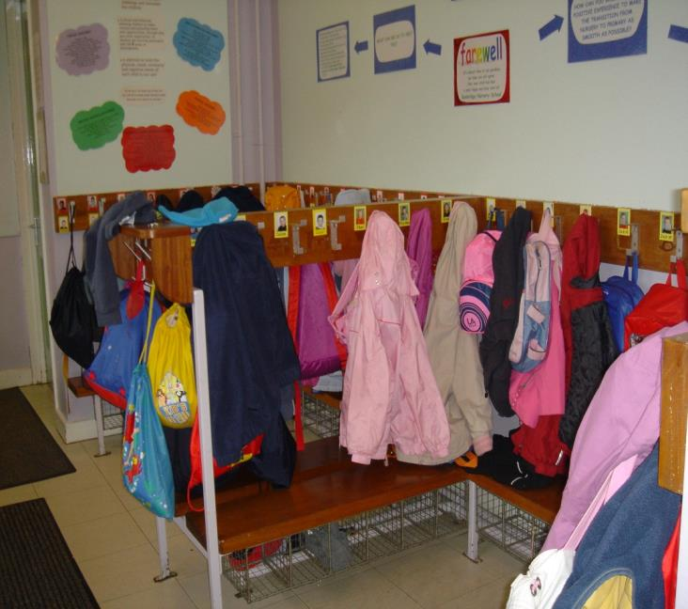
‘My New School’ Booklet example
I will use this door to go into Nursery each morning.
I will hang my coat and bag on my peg.
Notes:
This slides shows a photograph of the door into nursery and there is a photo of the cloakroom.

Slide 23
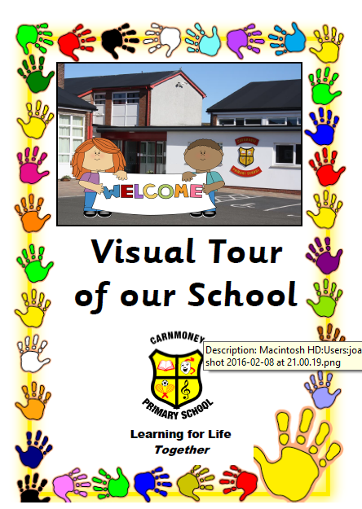
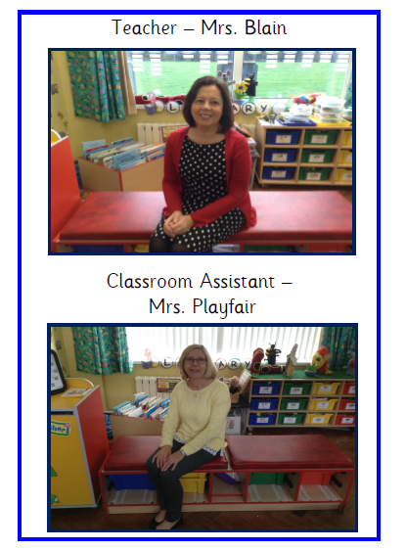
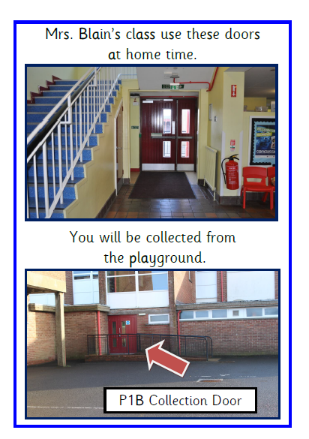
‘My New School’ Booklet
Notes:
This shows a photograph of the teacher and classroom assistant and also shows the doors used into the playground. Some schools have a virtual tour on their website.

Slide 24

Transition Top Tips
Take your child to visit their new setting/class, to familiarise them with their new environment and meet members of staff
Take advantage of induction days or opportunities to ‘Meet the new teacher’ but remember it may be beneficial to visit the new setting at a quieter time
Prepare your child in the count down to school by encouraging them to mark off the number of sleeps
Notes:
It is useful to make contact with school staff to arrange opportunities to visit your child’s new environment. If appropriate this could be at a time when they can explore without other children present. As it draws closer to the start date, using a visual countdown to show how many sleeps there are left can be helpful.

Slide 25

Transition Top Tips
Wash their new uniform so they smell/feel like their own clothes.
Display uniform so your child can become familiar with it
Practise putting on the uniform and shoes so your child can become used to the new textures and materials
Encourage your child to try on their new uniform on a regular basis so they become as independent as possible in dressing and undressing themselves
Notes:
Unfamiliar clothes and new uniform can cause anxiety for some children. Consider washing their uniform so it smells familiar and then hanging it in your child’s room. Take opportunities to try on the uniform and work towards your child dressing and undressing independently. If you feel there may still be a difficulty, talk to school staff to address these concerns together.

Slide 26
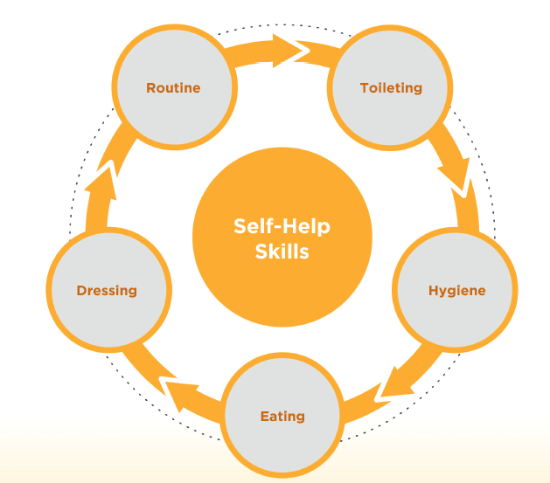
Transition Top Tips
Encourage independence throughout the day - going to the toilet, eating, changing shoes and clothes and putting on and taking off their coat
Notes:
Try to help your child become familiar with routines they will encounter at school. Work towards independence with hand washing, using the toilet, putting on and taking off their jumper and coat and using cutlery.

Slide 27
Transition Top Tips
Encourage your child to recognise their belongings (coat, school bag, jumper, pencil case). It can be helpful to choose these items with your child and label them clearly
Notes:
Encourage your child to recognise their belongings, consider choosing ones they like for example, relating to a favourite character. Label everything clearly with your child’s name so that they can also be easily identified by school staff.

Slide 28
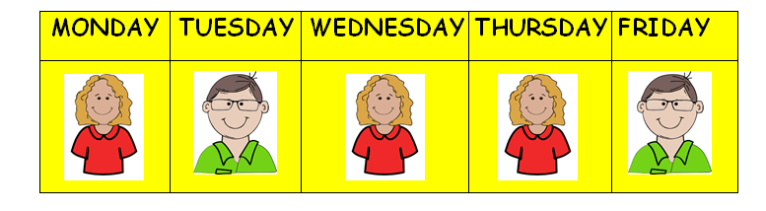
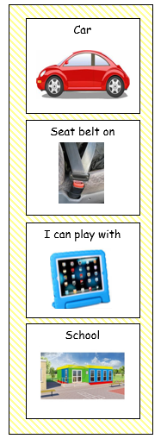
Transition Top Tips
Try to ensure a consistent and sustainable travel routine is established on ‘day one’
Re-assure your child that when they are dropped off at school they will be picked up at home time and you will see them soon. Make sure they know who is coming to pick them up.
Monitor how your child is coping with their transition from home to school. If they are finding this challenging, even after the initial first few weeks of school are over, a travel schedule may be helpful.
Notes:
Children with autism like routine. Try to establish clear and consistent rouitnes and where possible make sure your child knows who will be collecting them from school. It can be useful to show photographs of who will be picking them up, especially if it changes from day to day. Make school staff aware of any changes so they can provide reminders and reassurance. A travel schedule may be useful to visually show the steps involved in going to school.

Slide 29
Transition Top Tips
A transition object can be very helpful. This is an object the child brings to school which symbolises home life. It can be a small soft toy or photograph, etc. Some children need something tangible from home as a comforter to make them feel safe. These objects can stay with the child initially, then be gradually phased out.
‘My school day’ social story can be helpful.
Talk to your child about starting school. There are lots of story books available that explore this topic.
Notes:
Some children will, at least initially, benefit from bringing a reminder of home to school with them. It is important that this is returned at the end of one day so that it can be brought back the next. Talk to school staff about how this might work for your child. Social stories and books abut going to school can be useful. There are many books available and social stories can be tailored for your child’s circumstances.

Slide 30
Practice is the key to success
Your child may need to practise skills we take for granted e.g. unscrewing drink bottles, opening snack boxes etc.
When teaching your child a new skill try to keep it at a manageable level, some skills make take longer than others to consolidate.
Notes:
Your child will have the opportunity to learn many new skills. Don’t expect them to learn everything at once but give them lots of chances to practice. Always work towards independence at a level appropriate for your child.

Slide 31


Visual supports
We all rely on visual supports as we go about our daily lives.
Children with ASD are visual learners. They learn better when they see things.
Pictures or photographs can be very helpful to a child with ASD.
Notes:
We all rely on visual supports as we go about our daily lives. Children with autism are often visual learners and when they can see an object, photograph or symbol, what we say and what we mean can make more sense. Use visual supports to teach new skills and routines. These visual supports can be useful to help generalise skills between settings. We are going to look at some examples of visual supports.

Slide 32
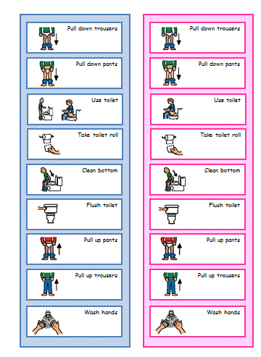
Resource examples Toilet Routine
Notes:
A toilet routine shows the steps involved in using the bathroom. This may need to be adapted for your child depending on their individual needs.

Slide 33
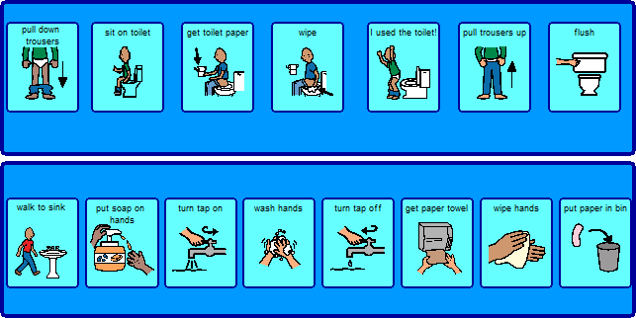
Resource examples Washing Hands Routine
Notes:
This shows the steps involved in washing hands and can be sued to teach or remind your child what to do. Make sure the symbols are accurate and relevant. Consider taking photographs of your child at each stage and using these as prompts.

Slide 34
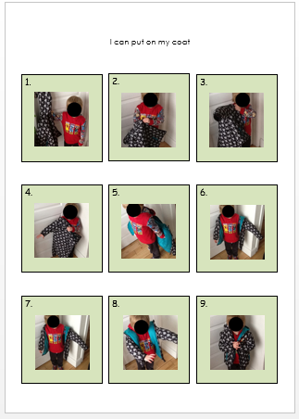
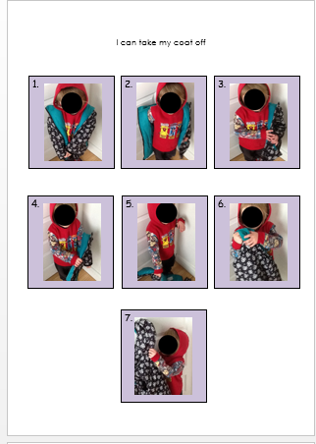
Resource examples Coat visuals
Notes:
Some children will benefit from visual supports to show how to put on and take off their coat. This could be displayed in the cloak room in school as a reminder.

Slide 35
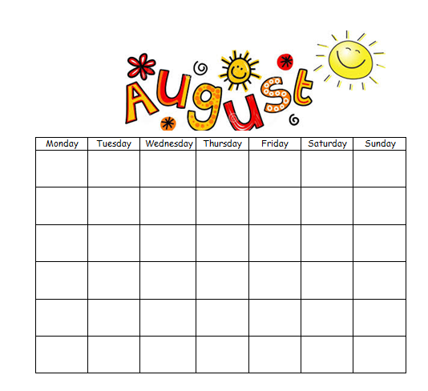
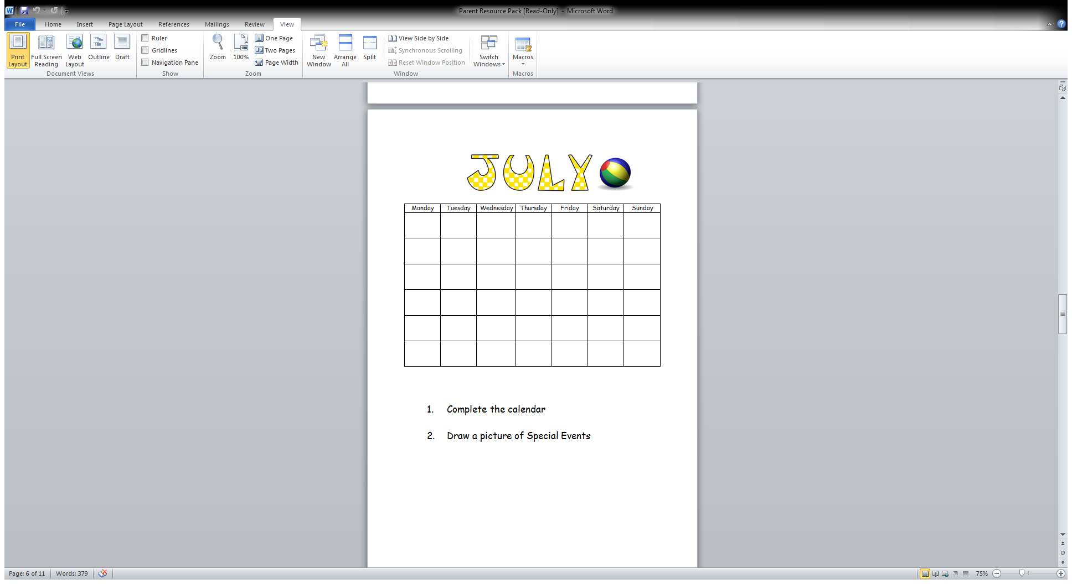
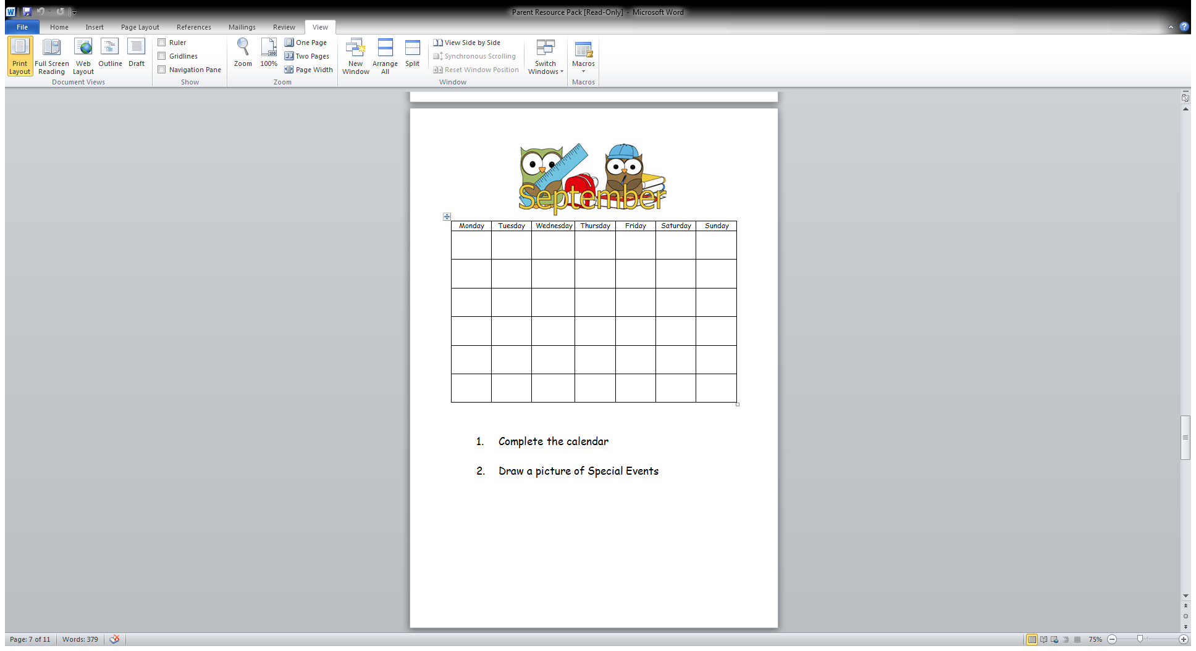
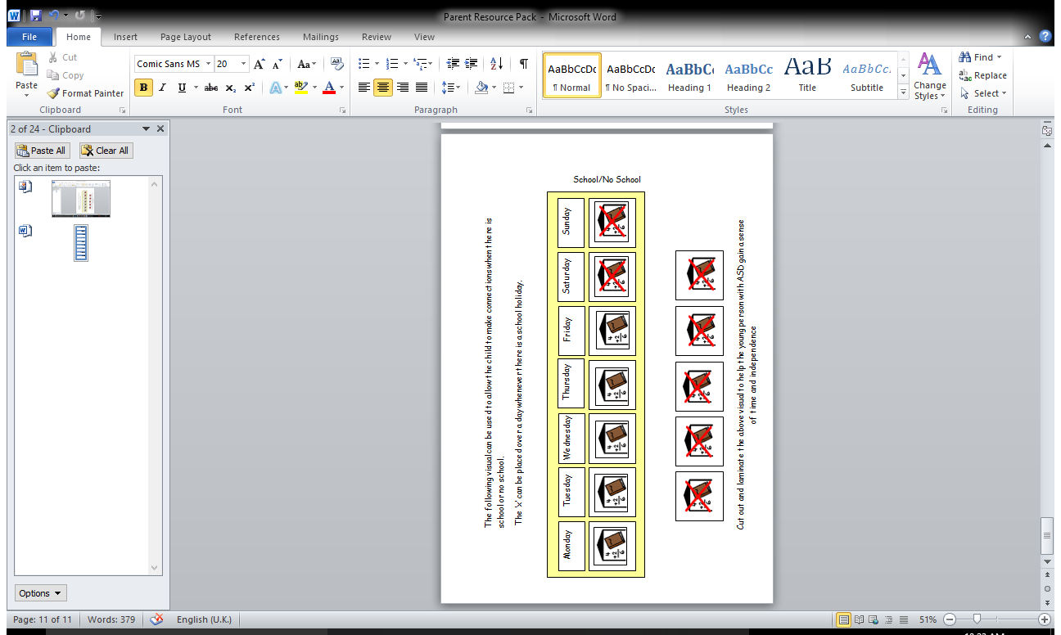
Resource examples Calendar
Notes:
Calendars may be useful to show when there is school and when there is a holiday.

Slide 36
Resource examples Sleeps until I start school
Notes:
This indicates how many sleeps there are until school starts. Together, you can cross out each picture until there are none left.

Slide 37
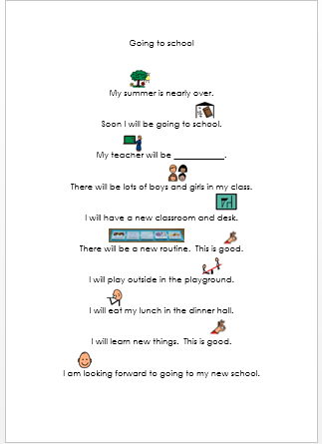
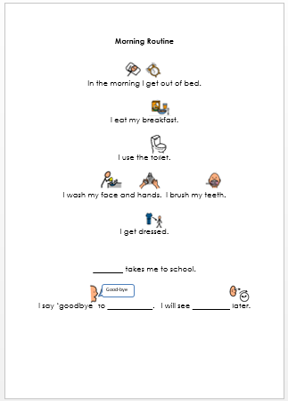
Resource examples Social story
Notes:
Social stories use short phrases and clear information to help your child understand new situations. Where possible these should be written positively, offering encouragement. Personalise these for your child’s routine.

Slide 38
Resource examples Travel Schedule
Notes:
This provides an example of a travel schedule. Consider using photographs and make the pictures relevant to your child.

Slide 39


What the teachers said…
“Take advantage of additional visits to the classroom if your child needs that.”
“It can be very helpful if children have practised wearing their new uniform.”
“It is a great help if children have practised using their new lunch box.”
Notes:
Staff want your child’s experience at school to be positive and a success. Some of our teachers said: “Take advantage of additional visits to the classroom if your child needs that.”
“It can be very helpful if children have practised wearing their new uniform.”
“It is a great help if children have practised using their new lunch box.”

Slide 40

What the teachers said…
“Information shared about the child, especially regarding likes, dislikes and potential triggers can be very helpful.”
“It is so important for there to be good communication and liaison between home and school.”
Notes:
Information shared about the child, especially regarding likes, dislikes and potential triggers can be very helpful. It is so important for there to be good communication and liaison between home and school. Work in partnership with school staff so that your child settles into their new routine.

Slide 41
Contact Us Please feel free to contact the AAIS if you have any questions
Office Area | Telephone Number
Armagh | 028 3831 4471
Ballymena | 028 2566 1480
Belfast | 028 9078 4230
Dundonald | 028 9056 6392
Omagh | 028 8225 4552
Notes:
The Early Years team of the Autism Advisory and Intervention Service hope that you have found the information provided helpful. Should you require further advice or guidance, you can contact us at the numbers listed. We wish you and your child well as they transition to a new stage of their school life.

